Slide 1


Slide 2
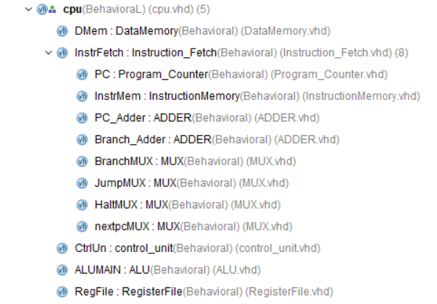
Structure

Slide 3
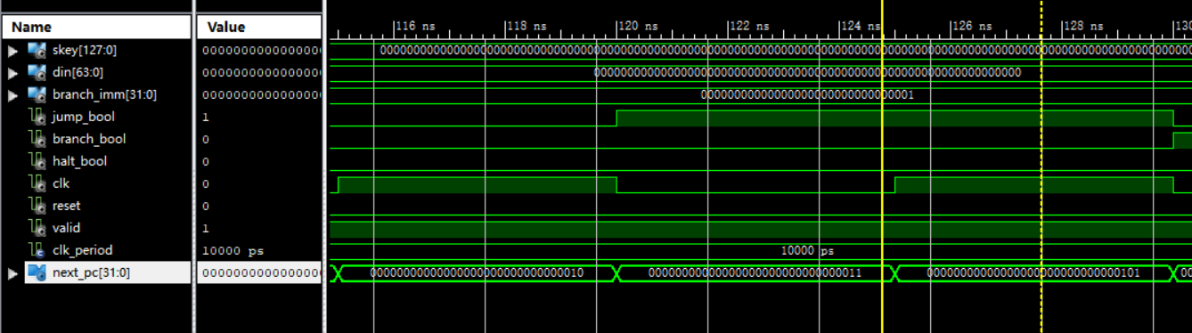
Functional Simulation
Instruction Fetch_PC Jump

Slide 4
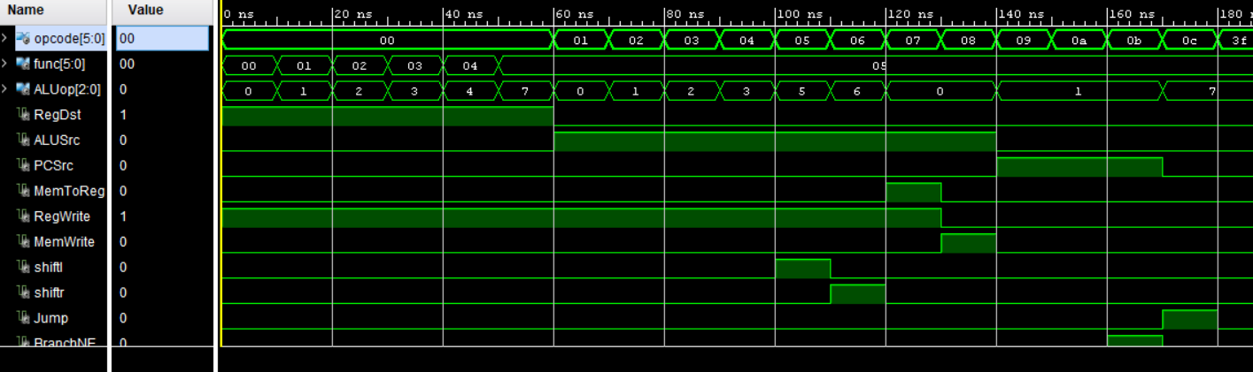
Functional Simulation
Control Unit

Slide 5
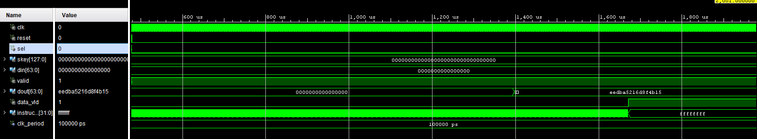
Functional Simulation
Integrated Processor_Enc

Slide 6
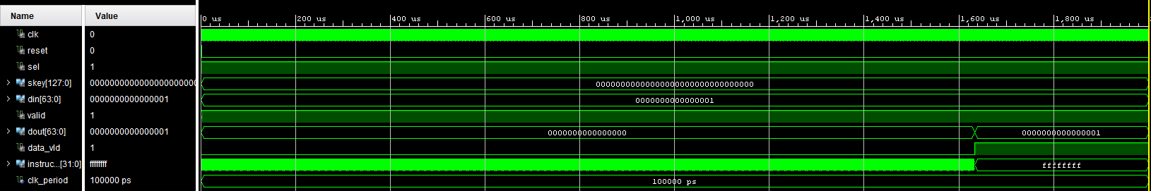
Functional Simulation
Integrated Processor_Dec

Slide 7
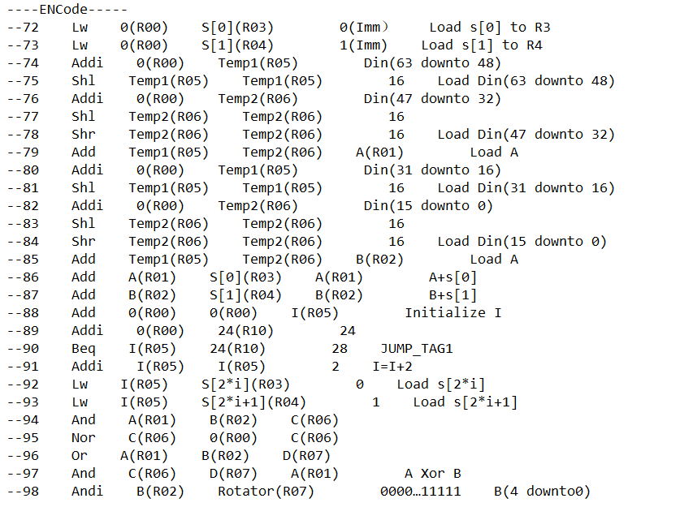
Assembly Code

Slide 8
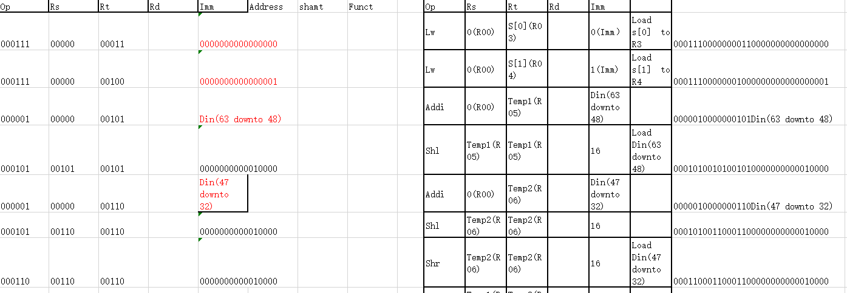
Machine Code

